Slide 1
Ebola Disease
By
Dr. Hussein AlNaji

Slide 2
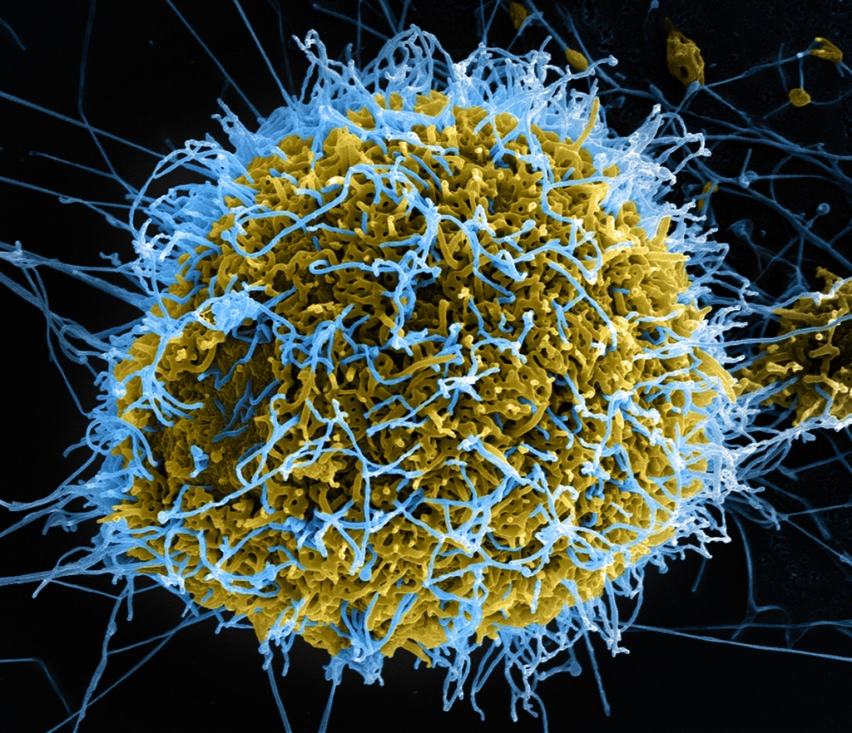
Overview
Ebola disease is the term for a group of deadly diseases in people caused by four ebolaviruses within the genus Ebolavirus. There are occasional Ebola disease outbreaks in people, occurring primarily on the African continent..

Slide 3
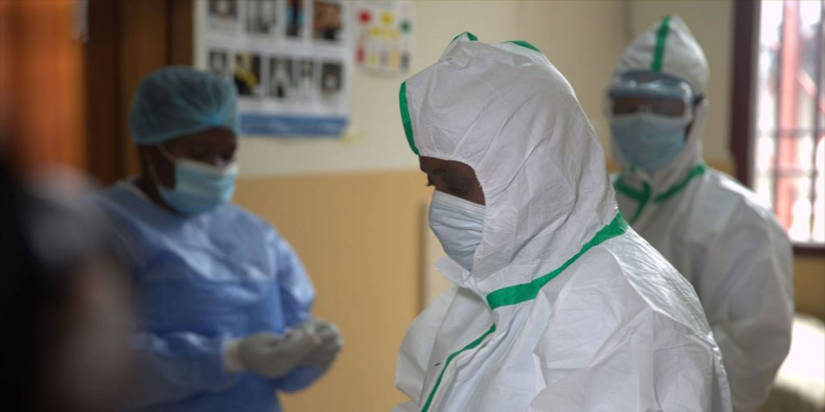
The name of each of the four ebolaviruses that cause illness in people, with their associated viral species1 and disease name2 can be found below:
1- Ebola virus (species Zaire ebolavirus) causes Ebola virus disease
2- Sudan virus (species Sudan ebolavirus) causes Sudan virus disease
3- Taï Forest virus (species Taï Forest ebolavirus, formerly Côte d’Ivoire ebolavirus) causes Taï Forest virus disease
4- Bundibugyo virus (species Bundibugyo ebolavirus) causes Bundibugyo virus disease

Slide 4
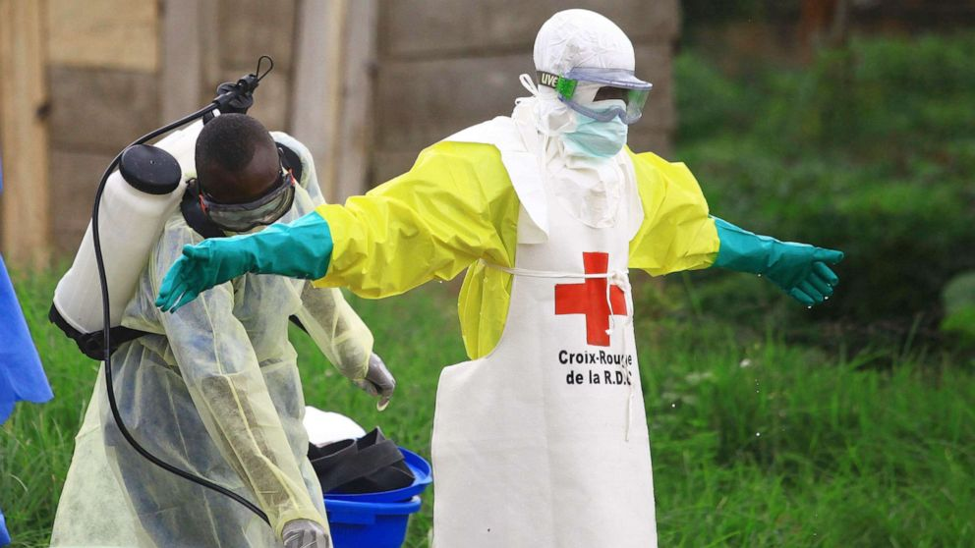
Transmission
scientists think people are initially infected with an ebolavirus through contact with an infected animal, such as a fruit bat or nonhuman primate. This is called a spillover event. After that, the virus spreads from person to person, potentially affecting many people. Ebolaviruses spread through
1- Blood or body fluids (urine, saliva, sweat, feces, vomit, breast milk, amniotic fluid, and semen) of a person who is sick with or has died from Ebola disease.

Slide 5
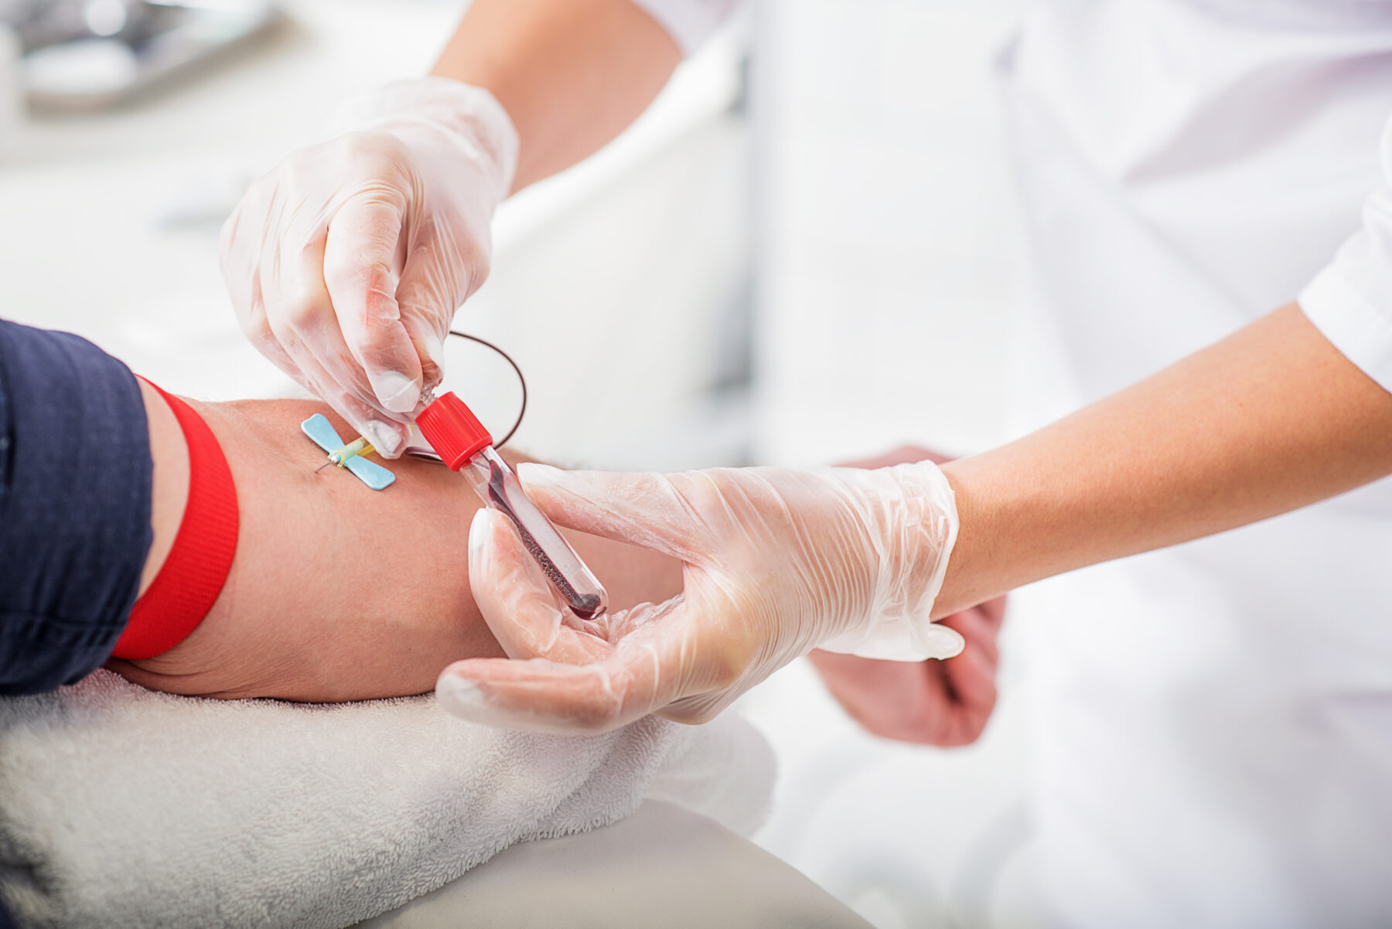
2- Objects (such as clothes, bedding, needles, and medical equipment) contaminated with body fluids from a person who is sick with or has died from Ebola disease.
3- Infected fruit bats or nonhuman primates (such as apes and monkeys).
4- Semen from a man who recovered from Ebola disease. Ebolaviruses can remain in certain body fluids (including semen) of a patient who has recovered from Ebola disease, even if they no longer have symptoms of severe illness.

Slide 6
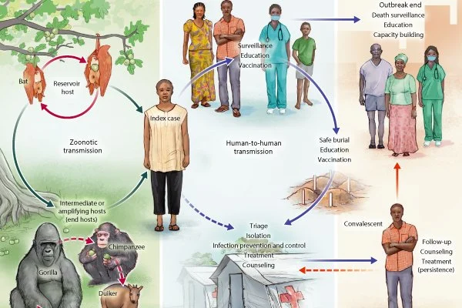

Slide 7
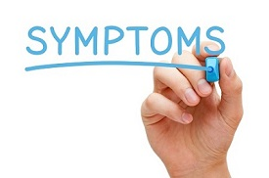
Symptoms
The symptoms of Ebola infection can be sudden and include fever, fatigue, muscle pain, headache and sore throat. These are followed by vomiting, diarrhoea, rash, and internal and external bleeding.
The time from when someone gets infected to having symptoms is usually from 2 to 21 days. A person with Ebola can only spread the disease once they have symptoms. People can spread Ebola for as long as their body contains the virus, even after they have died.

Slide 8
Diagnosis
It can be difficult to clinically distinguish Ebola virus disease from other infectious diseases such as malaria, typhoid fever and meningitis. Many symptoms of pregnancy and Ebola disease are also quite similar.
Confirmation that symptoms are caused by Ebola virus infection are made using the following diagnostic methods:
1- antibody-capture enzyme-linked immunosorbent assay (ELISA)
2- antigen-capture detection tests
3- serum neutralization test
4- Reverse transcriptase polymerase chain reaction (RT-PCR) assay
5- Electron microscopy

Slide 9
Treatment
People with symptoms of Ebola should get medical care immediately. Early care improves a person's chances of surviving Ebola.
For all types of Ebola, supportive treatments save lives and include the following:
1- Oral or intravenous fluids
2- Blood transfusions
3- Medicines for other infections the person may have, such as malaria
4- Medicines for pain, nausea, vomiting and diarrhoea.

Slide 10
Prevention and control
People can protect themselves from getting Ebola by:
1- Reducing the risk of wildlife-to-human transmission
2- Reducing the risk of human-to-human transmission
3- Outbreak containment measures, including safe and dignified burial of the dead
4- Reducing the risk of possible sexual transmission
5- Reducing the risk of transmission from pregnancy related fluids and tissue.

Slide 11
Thank You

